Slide 1
4. Affine transformations

Slide 2
Reading
Required:
  Watt, Section 1.1.
Further reading:
  Foley, et al, Chapter 5.1-5.5.
  David F. Rogers and J. Alan Adams, Mathematical Elements for Computer Graphics, 2nd Ed., McGraw-Hill, New York, 1990, Chapter 2.

Slide 3
Geometric transformations
Geometric transformations will map points in one space to points in another: (x',y',z') = f(x,y,z).
These tranformations can be very simple, such as scaling each coordinate, or complex, such as non-linear twists and bends.
We'll focus on transformations that can be represented easily with matrix operations.
We'll start in 2D...

Slide 4
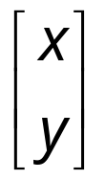

Representation
We can represent a point, p = (x,y), in the plane
  as a column vector
  as a row vector

Slide 5
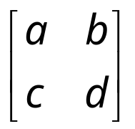
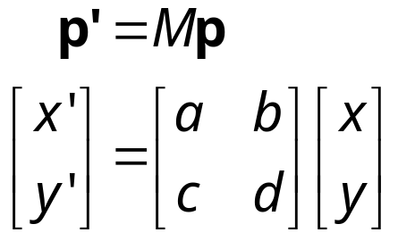
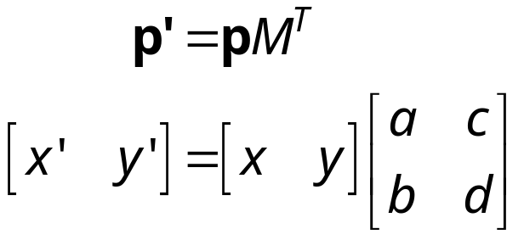
Representation, cont.
We can represent a 2-D transformation M by a matrix
If p is a column vector, M goes on the left:
If p is a row vector, M^{T} goes on the right:
We will use column vectors.

Slide 6
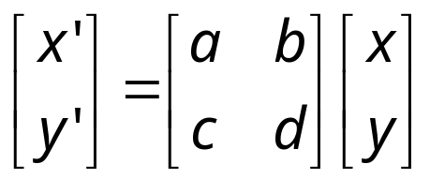
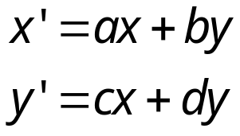
Two-dimensional transformations
Here's all you get with a 2 x 2 transformation matrix M:
So:
We will develop some intimacy with the elements a, b, c, d…

Slide 7
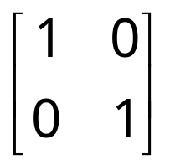
Identity
Suppose we choose a=d=1, b=c=0:
  Gives the identity matrix:
  Doesn't move the points at all

Slide 8
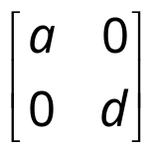
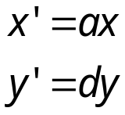
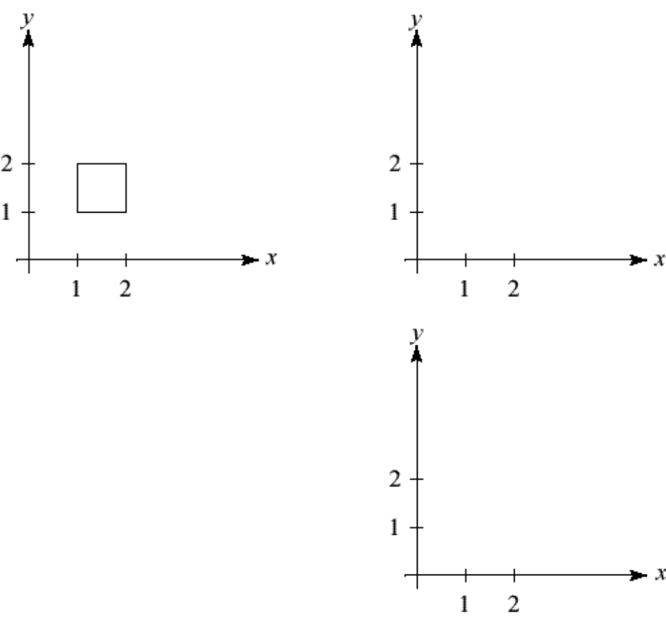
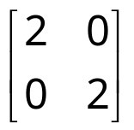
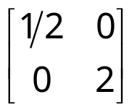
Scaling
Suppose we set b=c=0, but let a and d take on any positive value:
  Gives a scaling matrix:
  Provides differential (non-uniform) scaling in x and y:

Slide 9
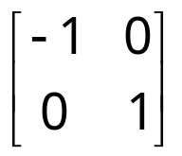
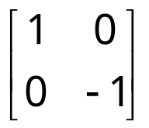
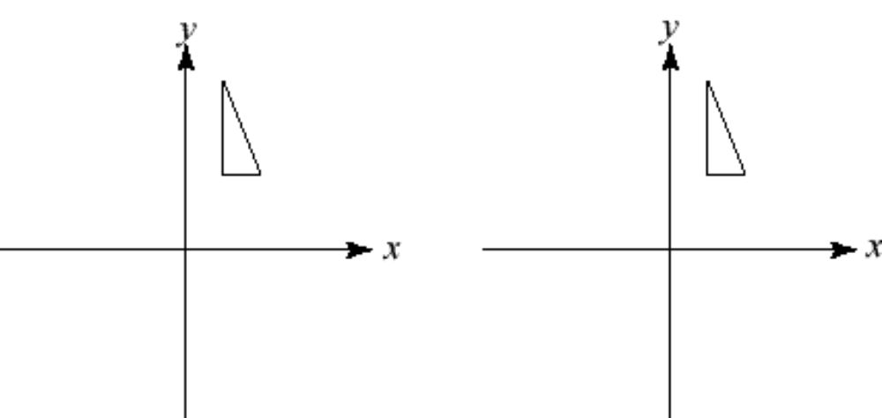
______________
Suppose we keep b=c=0, but let either a or d go negative.
Examples:

Slide 10
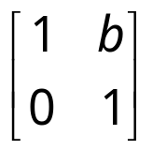
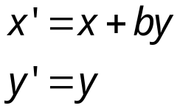
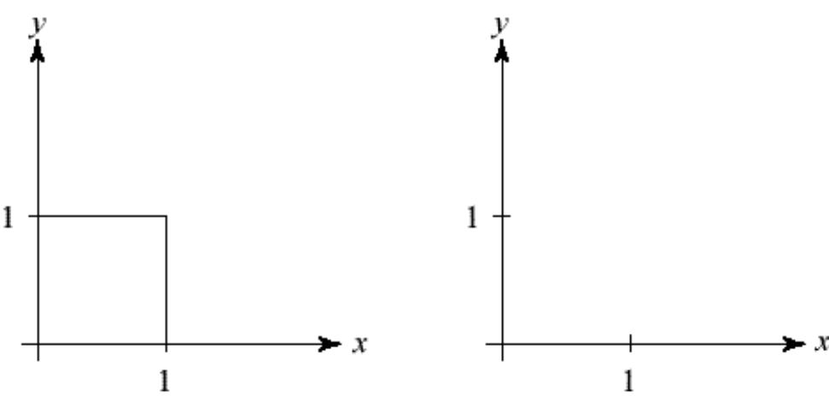
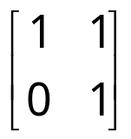
____________
Now let's leave a=d=1 and experiment b. . . .
The matrix
gives:

Slide 11
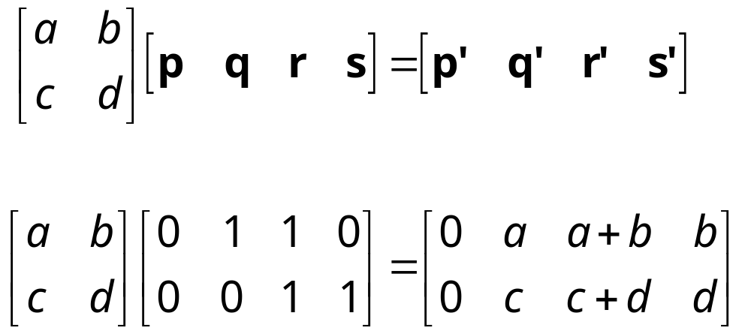
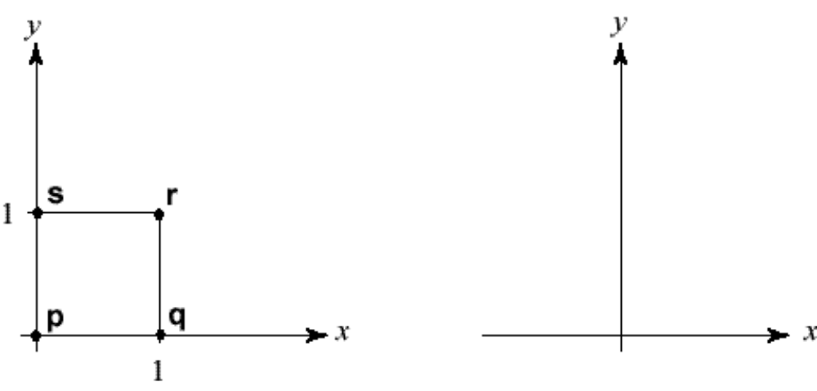
Effect on unit square
Let's see how a general 2 x 2 transformation M affects the unit square:

Slide 12
Effect on unit square, cont.
Observe:
  Origin invariant under M
  M can be determined just by knowing how the corners (1,0) and (0,1) are mapped
  a and d give x- and y-scaling
  b and c give x- and y-shearing

Slide 13
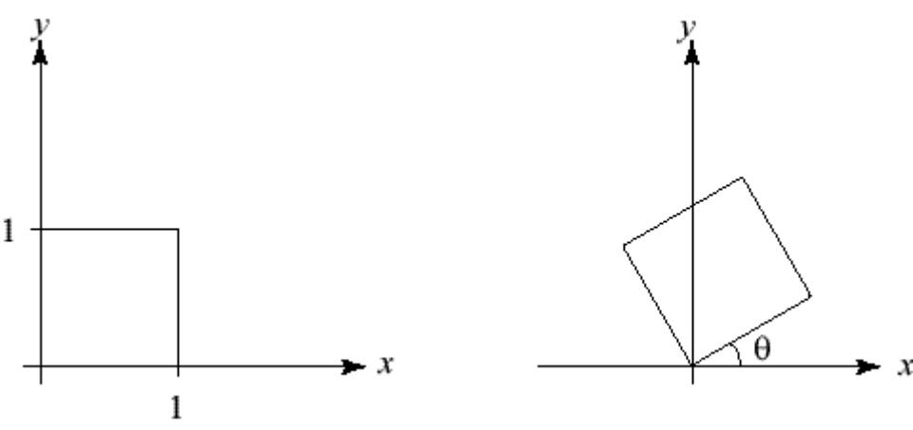
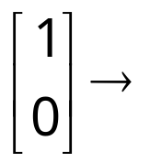
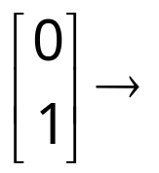
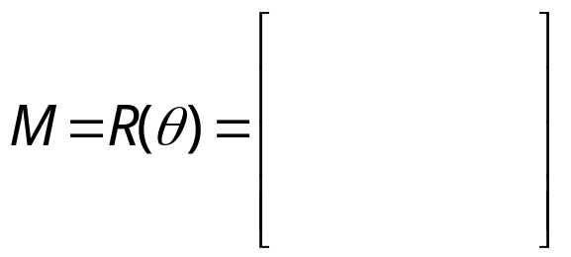
Rotation
From our observations of the effect on the unit square, it should be easy to write down a matrix for “rotation about the origin”:
  Thus,

Slide 14
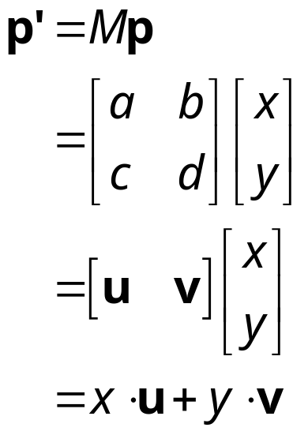
Linear transformations
The unit square observations also tell us the 2x2 matrix transformation implies that we are representing a point in a new coordinate system:
where u=[a c]^{T} and v=[b d]^{T} are vectors that define a new basis for a linear space.
The transformation to this new basis (a.k.a., change of basis) is a linear transformation.
Notes:
Show change of basis applet

Slide 15
Limitations of the 2 x 2 matrix
A 2 x 2 linear transformation matrix allows
  Scaling
  Rotation
  Reflection
  Shearing
Q: What important operation does that leave out?

Slide 16

Affine transformations
In order to incorporate the idea that both the basis and the origin can change, we augment the linear space u, v with an origin t.
We call u, v, and t (basis and origin) a frame for an affine space.
Then, we can represent a change of frame as:
This change of frame is also known as an affine transformation.
How do we write an affine transformation with matrices?

Slide 17
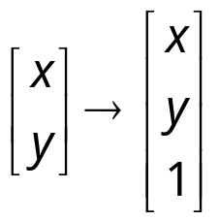
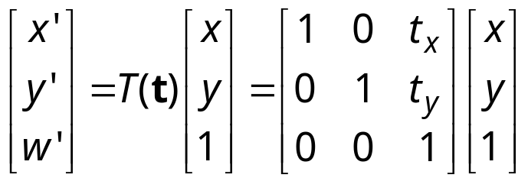
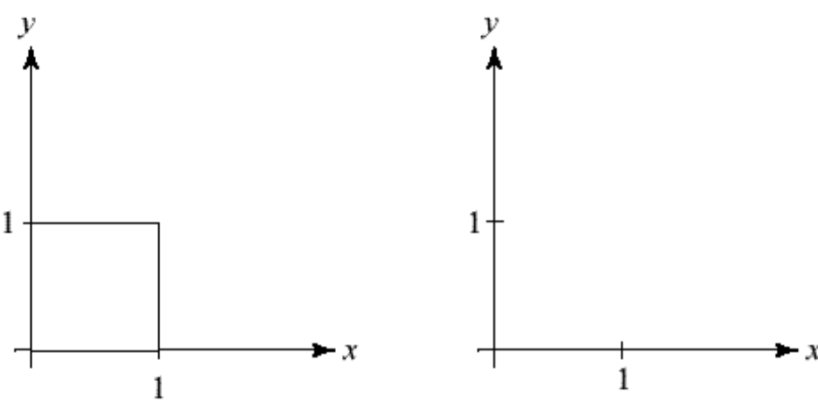
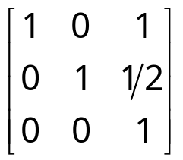
Homogeneous coordinates
Idea is to loft the problem up into 3-space, adding a third component to every point:
And then transform with a 3 x 3 matrix:
. . . gives translation!

Slide 18
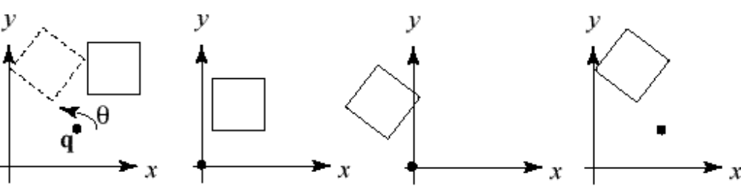
Rotation about arbitrary points
Until now, we have only considered rotation about the origin.
With homogeneous coordinates, you can specify a rotation, θ, about any point q = [q_{x} q_{y}]^{T} with a matrix:
Translate q to origin
Rotate
Translate back
Note: Transformation order is important!!
Notes:
Under figures: T(-q) R(theta) T(+q)
Written out: T(+q) R(theta) T(-q)

Slide 19
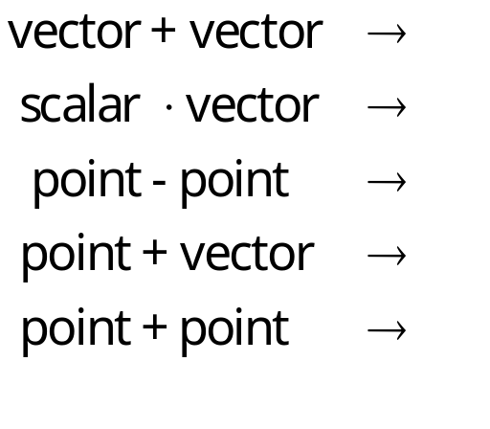

Points and vectors
From now on, we can represent points as have an additional coordinate of w=1.
Vectors have an additional coordinate of w=0. Thus, a change of origin has no effect on vectors.
Q: What happens if we multiply a matrix by a vector?
These representations reflect some of the rules of affine operations on points and vectors:
One useful combination of affine operations is:
Q: What does this describe?

Slide 20
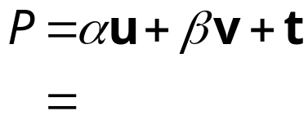
Barycentric coordinates
A set of points can be used to create an affine frame. Consider a triangle ABC and a point P:
We can form a frame with an origin C and the vectors from C to the other vertices:
We can then write P in this coordinate frame:
The coordinates (α, β, γ) are called the barycentric coordinates of P relative to A, B, and C.

Slide 21
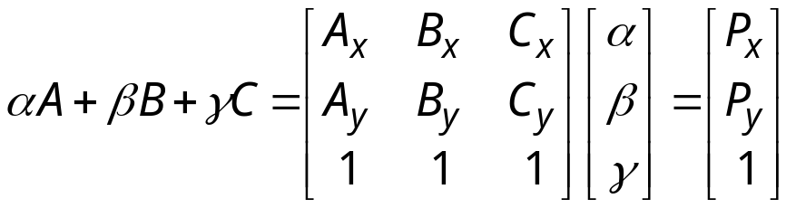
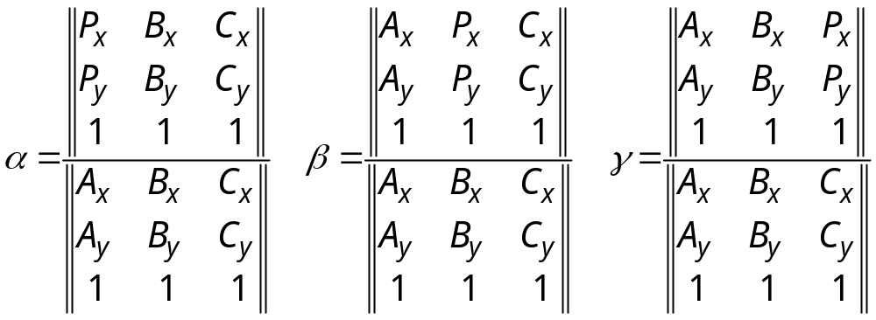
Computing barycentric coordinates
In the triangle example:
we can compute the barycentric coordinates of P:
Simple matrix analysis gives the solution:
Computing the determinant of the denominator gives:

Slide 22
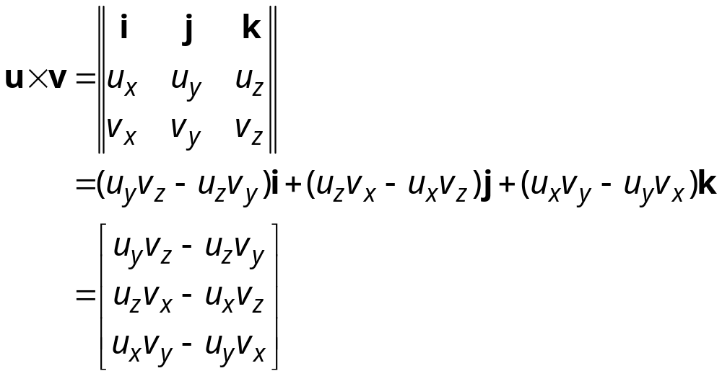
Cross products
Consider the cross-product of two vectors, u and v. What is the geometric interpretation of this cross-product?
A cross-product can be computed as:
What happens when u and v lie in the x-y plane? What is the area of the triangle they span?

Slide 23
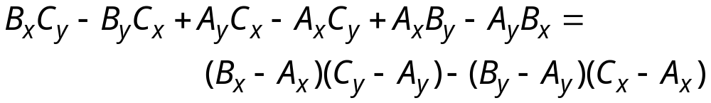
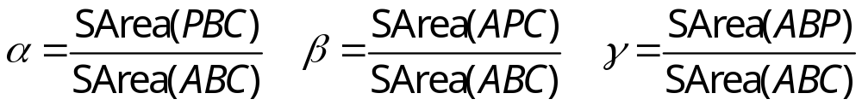
Barycentric coords from area ratios
Now, let’s rearrange the equation from two slides ago:
The determinant is then just the z-component of (B-A) x (C-A), which is two times the area of triangle ABC!
Thus, we find:
Where SArea(RST) is the signed area of a triangle, which can be computed with cross-products.

Slide 24

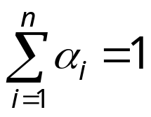
Affine and convex combinations
Note that we seem to have added points together, which we said was illegal, but as long as they have coefficients that sum to one, it’s ok.
We call this an affine combination. More generally:
is a proper affine combination if:
Note that if the α_{i} ‘s are all positive, the result is more specifically called a convex combination.
Q: Why is it called a convex combination?
Notes:
Given a collection of points, can call one of them the origin, say A_n, and subtract it from others and call them vectors.
Replace A_i with A_i - A_n.
Then, add back in alpha_1+…+alpha_n-1, which gives back A_n as the origin.
Convex combination because the result lies in the convex hull of the points.

Slide 25
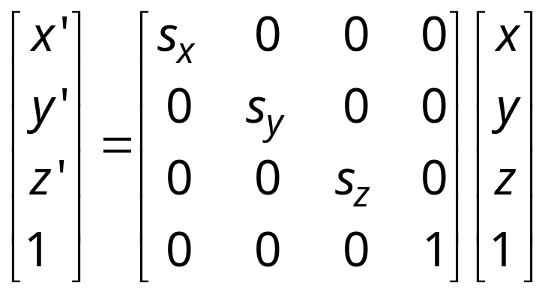
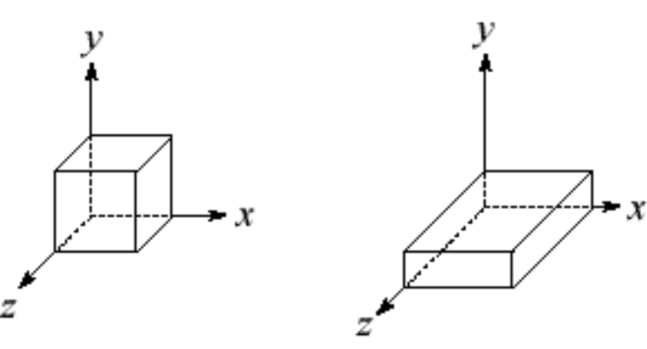
Basic 3-D transformations: scaling
Some of the 3-D transformations are just like the 2-D ones.
For example, scaling:

Slide 26
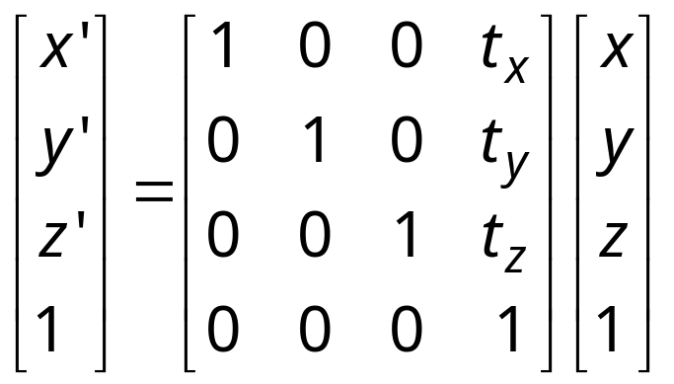
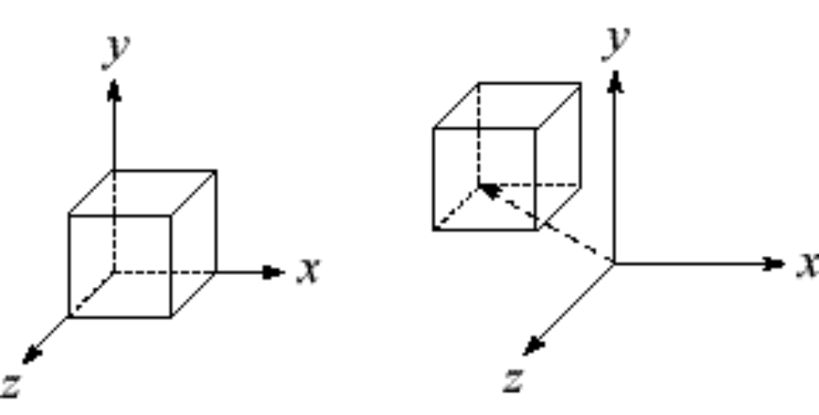
Translation in 3D

Slide 27
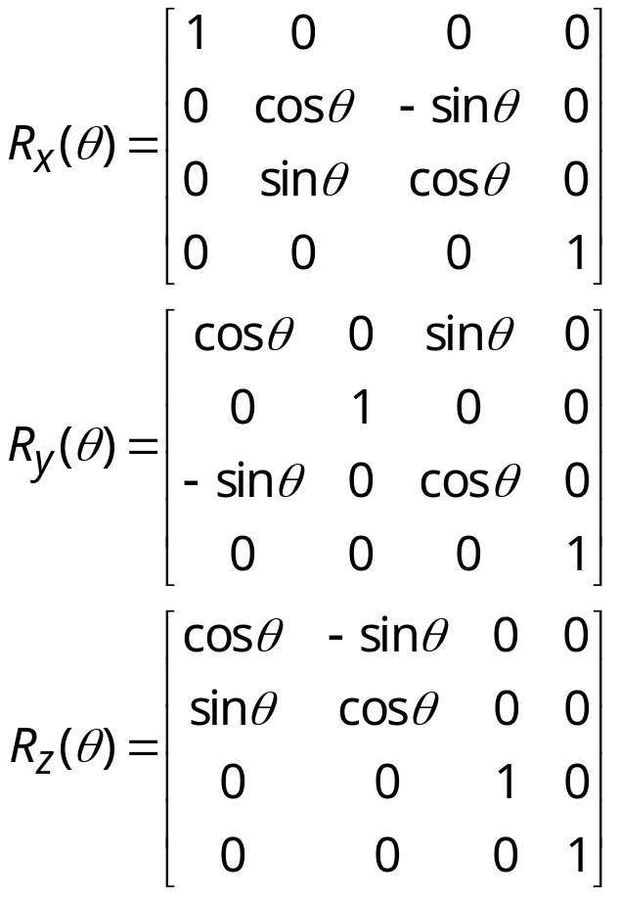
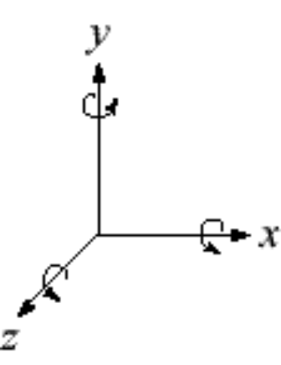



Rotation in 3D
Rotation now has more possibilities in 3D:
Use right hand rule

Slide 28
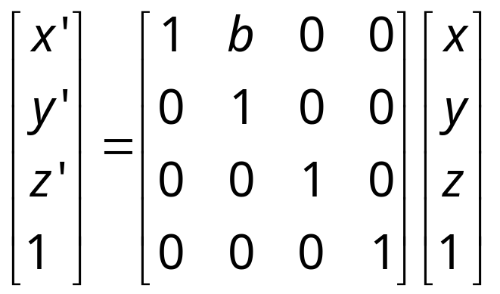
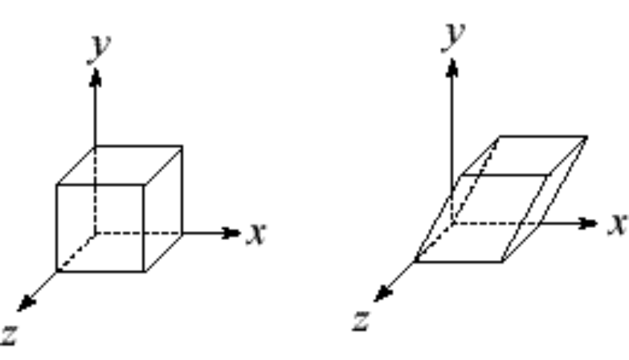
Shearing in 3D
Shearing is also more complicated. Here is one example:
We call this a shear with respect to the x-z plane.
Notes:
Think about other kinds of shearing…

Slide 29
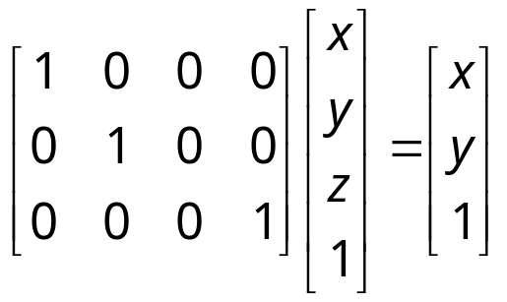
Preservation of affine combinations
A transformation F is an affine transformation if it preserves affine combinations:
where the A_{i} are points, and:
Clearly, the matrix form of F has this property.
One special example is a matrix that drops a dimension. For example:
This transformation, known as an orthographic projection is an affine transformation.
We’ll use this fact later…

Slide 30
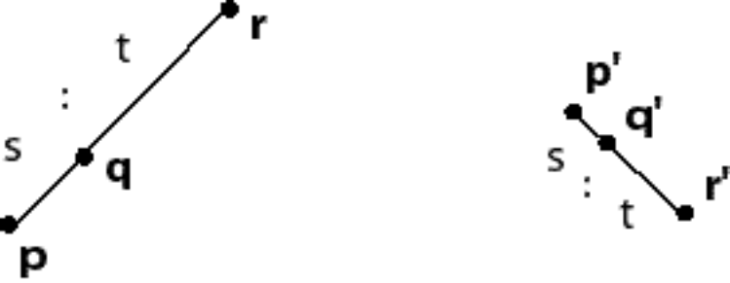
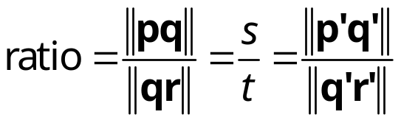
Properties of affine transformations
Here are some useful properties of affine transformations:
  Lines map to lines
  Parallel lines remain parallel
  Midpoints map to midpoints (in fact, ratios are always preserved)
→

Slide 31
Summary
What to take away from this lecture:
  All the names in boldface.
  How points and transformations are represented.
  What all the elements of a 2 x 2 transformation matrix do and how these generalize to 3 x 3 transformations.
  What homogeneous coordinates are and how they work for affine transformations.
  How to concatenate transformations.
  The rules for combining points and vectors
  The mathematical properties of affine transformations.

